Slide 1
Moonshot Project
Laurent BOUQUIN

Slide 2
Past Projects

Slide 3
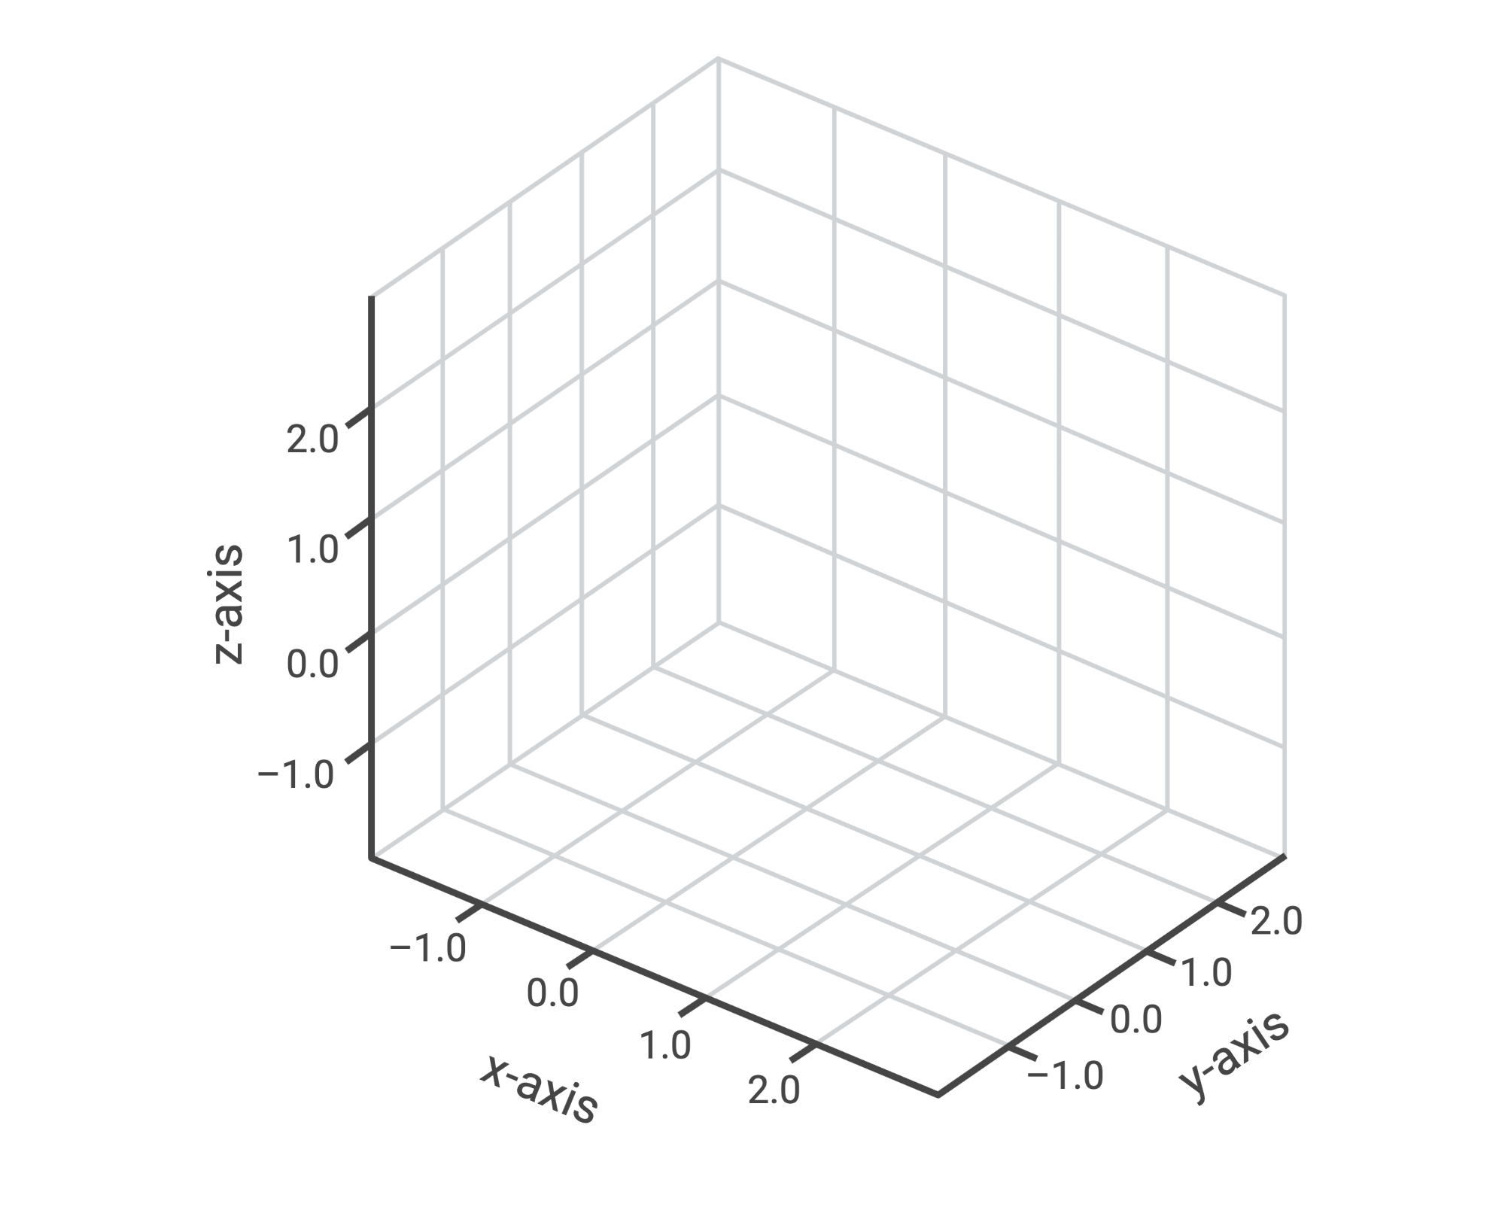

Drone Show

Slide 4
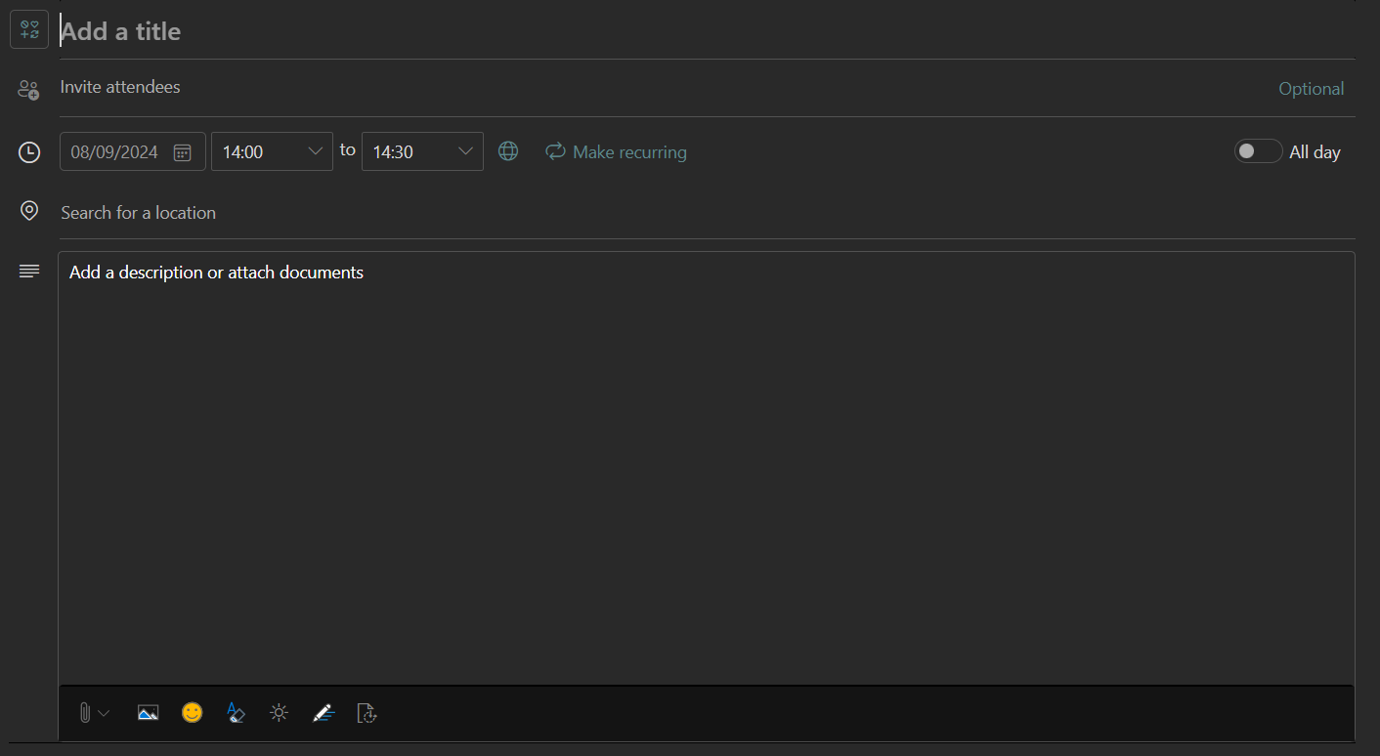
Planning Manager

Slide 5
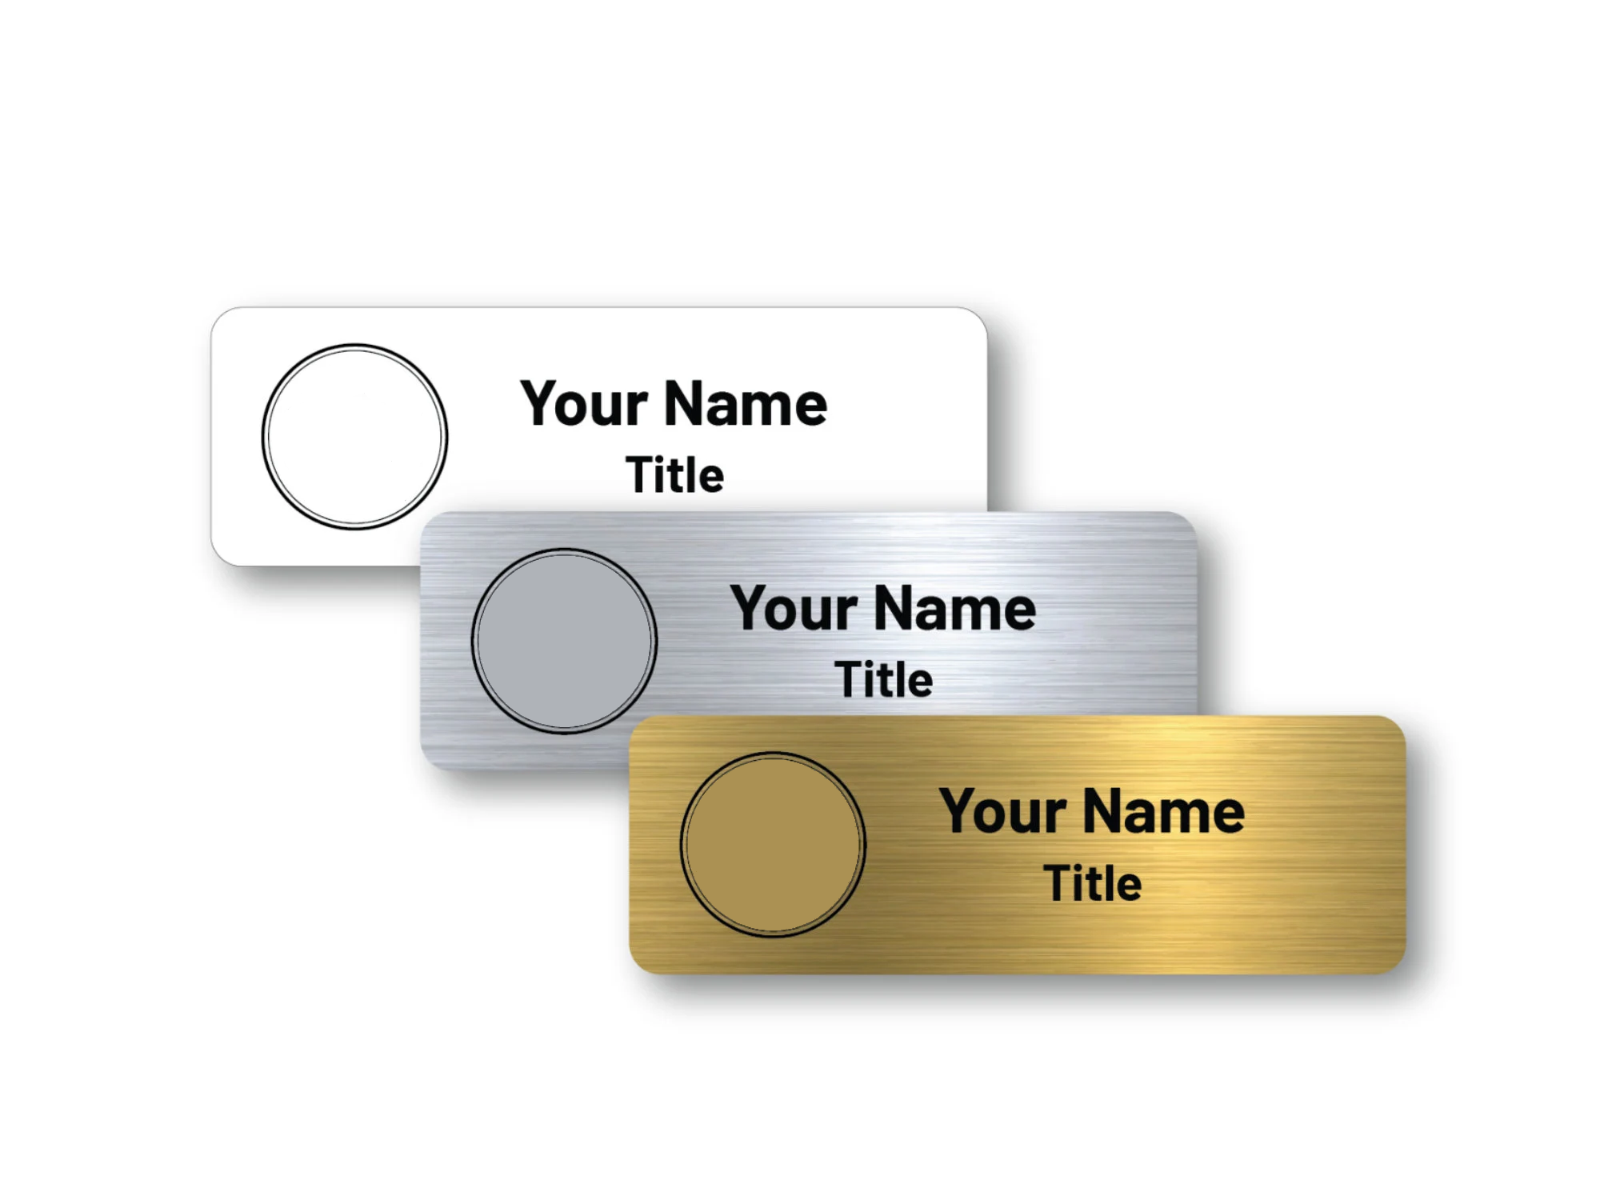

Room Detector

Slide 6
Linter Extension

Slide 7

Principle
"double quotes"
'single quotes'
RULES

Slide 8


The Big Wall!

Slide 9



The Big Wall!

Slide 10
Extension Creator

Slide 11
Why Doing It?
EASY
HARD

Slide 12
10 614
PROGRAMMING LANGUAGES EXTENSIONS
ON THE MARKETPLACE

Slide 13


What Does It Do?

Slide 14


How Does It Work?

Slide 15
How Does It Work?
Publisher Name
Extension Name
Version
Description
Type
Keywords
Format
Comments
Strings
Snippets

Slide 16


Technologies

Slide 17
DEMO

Slide 18
Future Versions

Slide 19
Version 2.0.0
Add Commands
Create REAMDE.md
Define Snippets

Slide 20
Version 2.0.0
Key Bindings
Publish From App
Define Acitvation Events

Slide 21
Version 3.0.0
Create Liscence File
Create Changelog File
Change Extension Type

Slide 22
Version 3.0.0
Create Tests From App
Set A Template

Slide 23
Question Time

